Slide 1
Dog with Pancreatitis
Pharmacology and Pharmacy
Spring 2015
Tarleton State University
04/26/2015

Slide 2
Group 2 Case Study 2
Michelle Hervey, LVT
Jennifer Hohle, LVT
Ashley Lawley, LVT

Slide 3
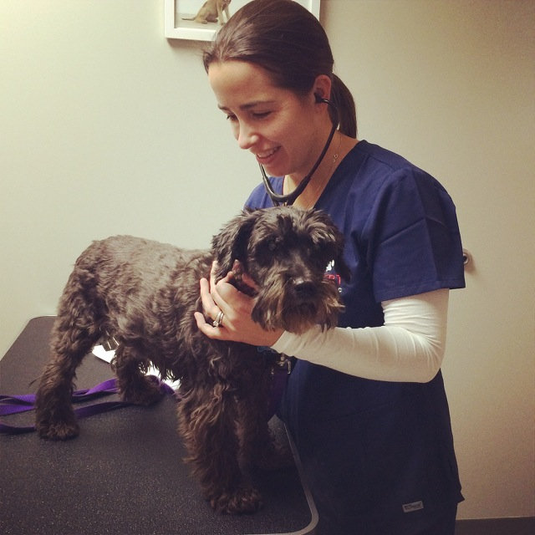
Scenario
Mrs. Glover brings her 5 year old Miniature schnauzer, Hansel, to the clinic because this morning he vomited twice and won’t play with any of his toys. Hansel is neutered, his last weight was 48lb, which gives him a BCS of 5/5 and he is usually very friendly. Today he is cranky and seems sore when you touch him. You ask whether Hansel has been outside unsupervised; he hasn’t been. You ask whether Mrs. Glover is feeding the Hill’s prescription diet R/d that Dr. Kallem prescribed at Hansel’s last visit. Mrs. Glover says she’s been feeding it but Hansel hates it so much that last night he stole a rib-eye off the picnic table.
Upon physical examination, Hansel is depressed, weight 44lb, rectal temperature 102, respiratory rate 48 bpm, heart rate 128 bpm. His gums are normal colored, but his refill time is 2.5 seconds. When you palpate his abdomen he wretches, and he stands in a praying position.
http://www.chestnuthilllocal.com/wp-content/uploads/2015/03/Patten.jpg

Slide 4
You identified acute pain based on the physical examination. Identify clinical signs that substantiate this evaluation?
http://www.apetslife.ca/images/dogpainsign.jpg
One of the clinical signs of pancreatitis is presence of abdominal pain upon abdominal palpation.
Elevated respirations can also be a sign of pain.

Slide 5
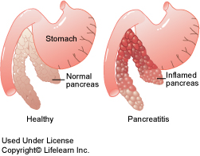
Your doctor suspects acute pancreatitis and has you pull blood for a CBC, chemistry panel, and cPLI. The CBC suggests the presence of inflammation; the chemistry panel demonstrates dehydration, elevated amylase and lipase values that are three times normal. Identify the acronym WNL. Mrs. Glover asks, “What’s the significance of the elevations in amylase and lipase?” Please explain.
WNL stands for Within Normal Limits.
The significance in the elevations of the amylase and lipase are indications of acute pancreatitis.
Because the amylase and lipase are increased at the same time, and three times the normal range this is a strong indication of pancreatitis. Amylase and lipase are important digestive enzymes that are secreted from the pancreas through a duct system to the first portion of the small intestine. When this duct system becomes inflamed the enzymes back up into the peripheral circulation, and this is why we can see in the blood serum; elevated levels of amylase and lipase at the same time. These elevated levels are helpful diagnostics for canine patients.
http://www.lifelearn-cliented.com/cms/resources/body/851/pancreatitis_2009.jpg

Slide 6
What is cPLI? Why is the test used?
cPLI stands for canine Pancreatic Lipase Immunoreactivity.
The cPLI test is a blood serum test that screens for pancreatitis. Pancreatic lipase inhibitor levels increase dramatically, suggesting that pancreatic inflammation and irritation are occurring (Rosenfeld, 2010).

Slide 7
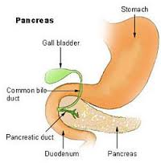
Mrs. Glover has never heard of pancreatitis. She asks you, “What is the function of the pancreas? Where is it located?
The pancreas is made up of two flat lobes that are located between the descending duodenum and the stomach.
The pancreas actually has two important functions. The greatest portion of the pancreas which is called the exocrine pancreas secretes important digestive enzymes through the duct system to the first portion of the small intestine. These enzymes are called amylase, lipase, and trypsin. The smaller portion of the pancreas which is known as the endocrine pancreas; produces a hormone called insulin. The insulin is produced to move glucose, amino acids, and fatty acids into the body cells for energy, and lower blood glucose levels.
http://www.healthhype.com/wp-content/uploads/pancreas_gland.png

Slide 8
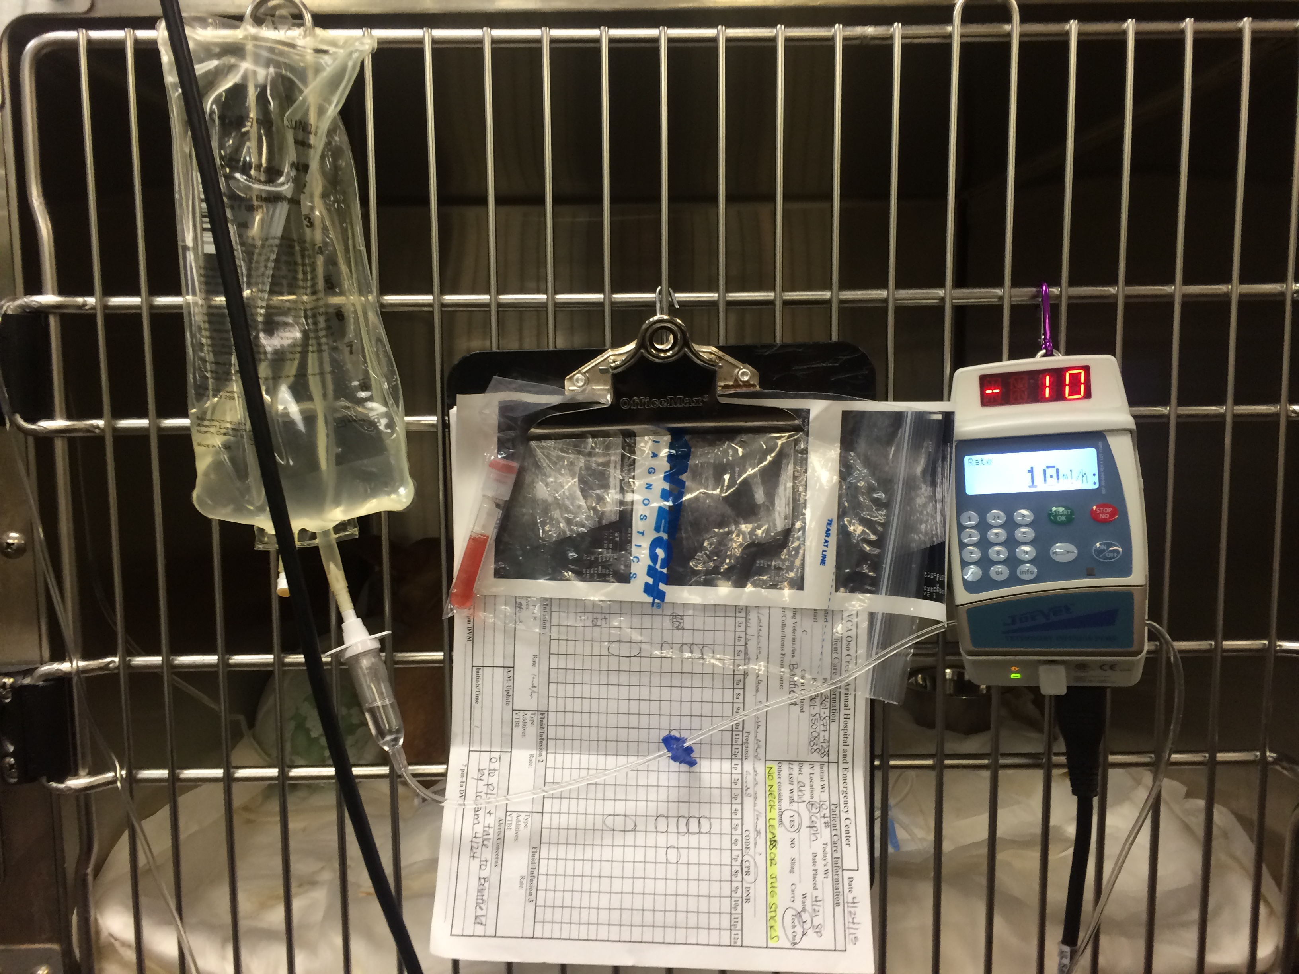
Dr. Kallem wants a constant rate infusion of buprenorphine hydrochloride in the Normosol fluids that Hansel will receive in the next six hours. She prescribes 20 mg/kg of fluid and 0.01 mg/kg of buprenorphine for this interval. Calculate the volume of fluid Hansel will receive in the six hours based upon the ordered rate.
48lbs x 1kg/2.2lbs = 21.8 kg
21.8 kg x 20 mg/kg = 436 mg of fluid
21.8 kg x 0.01 mg/kg = 0.21 mg Buprenorphine

Slide 9
Calculate the total volume in cc of buprenorphine Hansel will receive. The concentration of buprenorphine is 1mg/ml. Identify the class of drug to which Buprenorphne belongs. Is this a scheduled drug?
21.8 kg x 0.01 mg/kg = 0.21 mg
0.21 mg x 1mg/mL = 0.21 mL
Buprenorphine is a Class 2 scheduled drug.

Slide 10
Dr. Kallem has the dog listed as NPO for 24 hours. Later in the afternoon, a kennel helper stops in front of Hansel’s cage with two bowls of food in her hands. You ask her to leave immediately so he won’t even smell the food. Identify the acronym NPO.
NPO stands for nil per os, it’s a notification to withhold food or anything oral for the patient. It’s a latin term literally meaning “nothing through the mouth”.
https://www.unitedadlabel.com/media/catalog/product/cache/1/image/9df78eab33525d08d6e5fb8d27136e95/U/L/ULHN404_1.jpg

Slide 11
Continued… Explain why Hansel should not even smell the food when he is NPO
Hansel should not even smell food because the point of having him NPO is so that his gastrointestinal system and pancreas can rest. The smell of the food will can make him nauseated causing him to vomit or start hypersalavating. The smell of food can also cause his pancreas to react by producing digestive enzymes.

Slide 12
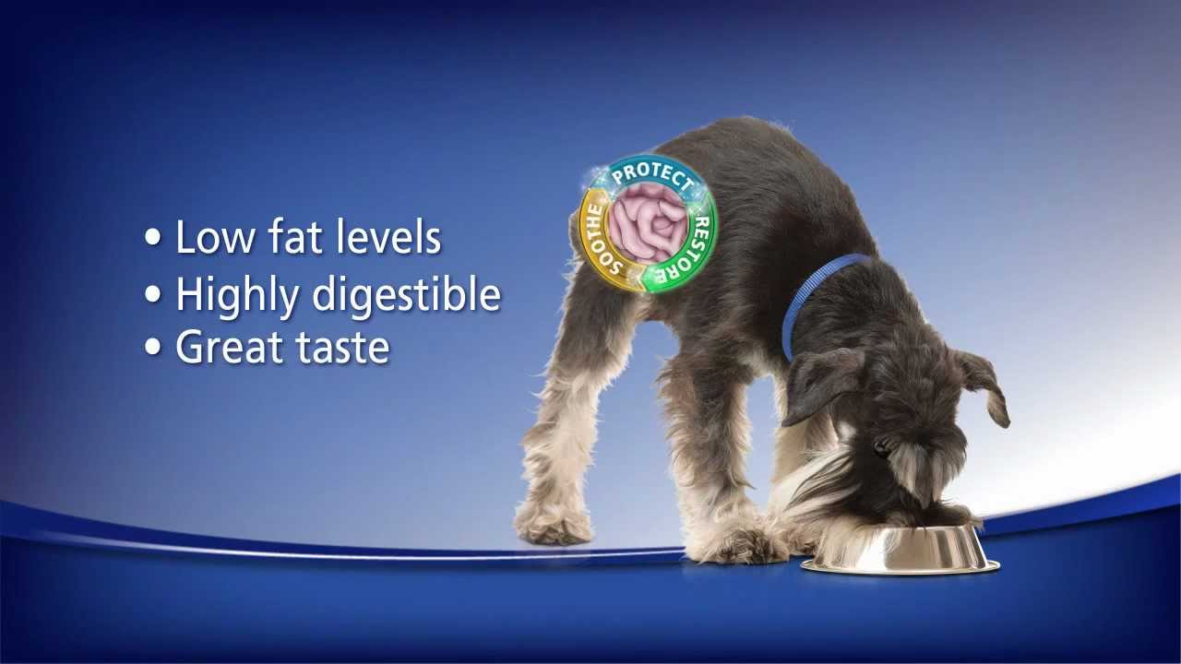
Hansel responds well to hospitalization and therapy. When Dr. Kallem sends him home after four days, she asks you to explain to Mrs. Glover why diet management is so important to Hansel. Please identify the salient points you will address with Mrs. Glover.
A low fat diet is extremely important for pets that are predisposed to pancreatitis. The goal of a specialized diet is to reduce requirements for digestive enzymes. The required diet would be low fat and highly digestible. A good choice if choosing prescription would be science diet I/d low fat. An added note is that Hansel needs to be on a strict dietary regimen with no table scraps and treats only OK’d by Dr.
http://i.ytimg.com/vi/0bDQ2BIl_kg/maxresdefault.jpg

Slide 13
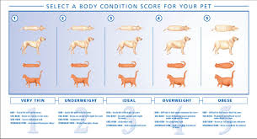
Identify physical examination findings that are typically seen with a BCS of 5/5.
The ribs are difficult to feel under a thick fat cover. The tailgate appears thickened and is difficult to feel under a prominent layer of fat. The bony prominences are covered by a moderate to thick layer of fat. In animals over 6 months there is a pendulous ventral bulge and no waist when viewed from the side. The back is markedly broadened when viewed from above (Bassert, 2010, p. 312).
("Beware the Westminster Kennel Club Dog Show")

Slide 14
Conclusion
Mrs. Glover brought her dog Hansel in right away when she first noticed he was not acting normal. Because she was able to act so quickly Hansel was treated immediately, and responded very well to his treatment. Mrs. Glover is able to take Hansel home after 4 days of being in the hospital. She is notified that Hansel will need to be on a low fat diet for the rest of his life because he is predisposed to getting pancreatitis. Hansel will need to be on a prescription diet called i/d that is made by Hills Science Diet. Mrs. Glover is also informed that Hansel cannot have any table scraps, or fatty treats because of his predisposition to pancreatitis. Also, Hansel has a 5/5 body condition score and will need to loose a few pounds. The i/d low fat diet will assist in Hansel’s weight loss.

Slide 15
References
Colville, T., Bassert, J. M..(2009) Clinical Anatomy and Physiology Laboratory Manual for Veterinary Technicians. Mosby Elsevier. St. Louis, Missouri. Print.
Colville, T., Bassert, J. M..(2008) Clinical Anatomy and Physiology for Veterinary Technicians Second Edition. Mosby Elsevier. St. Louis, Missouri. Print.
Hendrix, C. M., Sirois, M..(2007) Laboratory Procedures for Veterinary Technicians Fifth Edition. Mosby Elsevier. St. Louis, Missouri. Print.
Rockett, J., Christensen, C..(2010). Case Studies in Veterinary Technology A Scenario Based Critical Thinking Approach. Rockett House Publishing LLC. Heyburn, Idaho. Print.
Rosenfeld, A. J., Dial, S. M..(2010) Clinical Pathology for the Veterinary Team. Blackwell Publishing Ltd.. Ames, Iowa. Print
Summers, A..(2007). Common Diseases of Companion Animals Second Edition. Mosby Elservier. St. Louis, Missouri. Print.
Beware the Westminster Kennel Club Dog Show. (n.d.). Retrieved April 26, 2015, from http://www.theoptimaldog.com/2014/02/10/beware-the-westminster-kennel-club-dog-show/
Bassert, J. (2010). Small Animal Nutrition. In McCurnin's clinical textbook for veterinary technicians (7th ed., p. 312). St. Louis, Mo.: Elsevier Saunders.

